Slide 1
Prediction Of Heart Disease
Using Machine Learning

Slide 2
Basavaraj K Channur - 19bcs018
D Vishwas Reddy - 19bcs034
Datla Tarun Anjaneya Varma - 19bcs036
Priyam Keshwa - 19bcs052
Mopada Yaswanth - 19bcs073

Slide 3
Problem Statement
Build a Model for Heart disease prediction using Hybrid Machine learning techniques. (Binary Classification). Apply Ml algorithms on the data and predict whether the patient is having a heart disease.

Slide 4
Objectives
Predict whether a person is suffering from heart disease or not.
Find the patterns in the dataset and identify the relations among the features.
The health professional enters the input value from the patients health report. The data is fed into the model which predicts the probability of having a heart disease.

Slide 5
Literature Review
ANN’s are being used in medical field over the past few years. It has been tested even for this problem statement.
Effective Heart Disease Prediction Using Hybrid Machine Learning Techniques | IEEE Journals & Magazine**
Heart Disease Prediction Using Machine Learning Algorithms | IEEE Conference Publication
A LITERATURE SURVEY OF PREDICTING HEART DISEASE

Slide 6
Literature Review (Contd.)
The large amount of data that is available over the years has never been used efficiently
New approaches that have been used by us turned to perform better.
CNNs have been used and were able to generate features with various positions in the testing phase of the patients.

Slide 7
Dataset
Source from UCI Machine Learning repository. Combined various datasets to form a final large dataset.
Obtained from ECG scans and converted to csv format. Dataset is almost cleaned and readily available in kaggle.
Let’s look into the dataset and its features.
https://www.kaggle.com/datasets/fedesoriano/heart-failure-prediction

Slide 8
Methodology
Identify the required packages and understand the dataset.
Data Preprocessing
Model Training
Prediction of heart disease using the trained Models
HRFLM(proposed method)

Slide 9
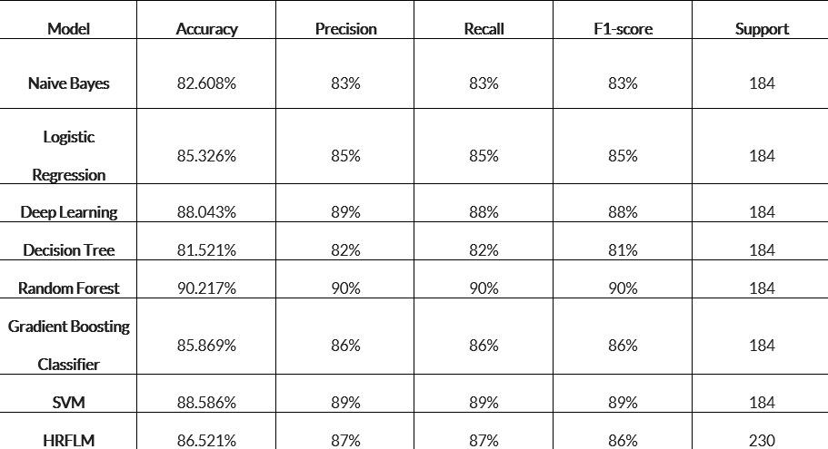
Results

Slide 10
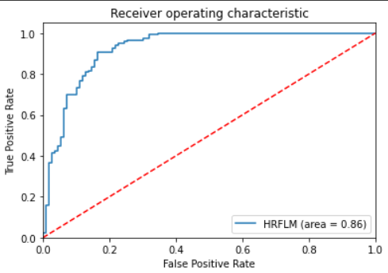
Results(Cont..)

Slide 11
Feature reduction
Eliminate few features and check the performance
Age and sex reduction from dataset

Slide 12
Conclusion
Gone through the problem statement
Explored various research papers
Looked into the process and workflow
Came up with satisfactory results

Slide 13
Thank You

